Slide 1
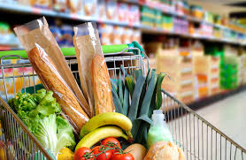
Food Survey During COVID-19
Submitted To Submitted By
Mr. Bose K.Shanmugapriya

Slide 2
Agenda
Problem Statement
Data analysis
Conclusion

Slide 3
Problem Statement
A NGO person want to help the people who are all suffering to have their food during the Quarantine period.
So wanted to analysis situation by sending Google forms.
He prepared list of the Necessary questions.
With help of response, he will come to some conclusions.

Slide 4
Availability of Grocery

Slide 5
Hike in Grocery price

Slide 6
Diet Plan

Slide 7
NON-Veg Intake

Slide 8
Breakfast

Slide 9
Lunch

Slide 10
Dinner

Slide 11
Family Income

Slide 12
No of Person in home

Slide 13
Conclusion
First, he will focus on the people where grocery are not available to them.
Based on the income, No. of person in each family and types on food intake, he will prepare the necessary grocery item to be delivered to them.
Then he will focus on the remaining people after them.
He gave Hand wash, Mask, Sanitizer to all the people.

Slide 14


Slide 15


